Slide 1

B.Tech Project , VIIIth Sem
External Evaluation Project Title: Controlling Basic Computer Functionalities With Hand Gesture
Presented by –
Rupansh Verma, 2019648435
Shubham Kumar Prajapati, 2019005595
Under the Supervision of--
Mr. Akhilesh Kumar Singh
Sharda University,
Gr. Noida
DEPARTMENT OF COMPUTER SCIENCE & ENGINEERING
SCHOOL OF ENGINEERING AND TECHNOLOGY
‹#›

Slide 2
Approval from guide for the evaluation

Slide 3
Contents –
Introduction & Motivation
Problem Statement
Idea and Approach
Related Work
Objectives of the Project
Requirements & Limitations
Dataset and Gestures
Current Hand gesture Market Stats
Global gesture recognition market
Functionalities
Technologies used in different researches
Implementation

Slide 4
Introduction
The advancement of new technology has been taking place since the beginning of human history but the advancement in technology has been exceptionally fast in the 20th and 21st century. With electronic technology and machines being produced and improved all the time.
With such advancement of technology, people are moving towards the Touchless technology to be more productive and automate the processes(like - opening/closing of the door,turning on street lights, use voice assistants etc).
Touchless technology is a form of electronics control technology that makes it possible for users to control a digital system without any form of physical contact.
The technology enables computer systems to take inputs/instructions in the form of physical movement, facial patterns, voice, and user behavior. These inputs are processed and interpreted by system algorithms to give the desired output or actions required by the user.
And the Hand Gesture Recognition is one of the active research areas in the field of human-computer interface and touchless technology due to its flexibility and user friendliness.

Slide 5
Motivation
As in the modern era computers are becoming more advanced and capable of doing more processing as compared to earlier computers. The hand gesture will allow us leverage in controlling the computer as there is less contact and more effectiveness.
With gestures we can operate the computer from farther distances, making it is much easier to use and user friendly.
Computers can be easy to use with gestures for new people, making them more user friendly.
And as the world is advancing to the era of technology and IoT, making a software to make computers work from hand gesture is a great approach to make computers easy to use and increase the productivity.
After going through the literature and seeing projects on gesture recognition , we found that there has not been any significant project built on controlling the Computer using hand gesture.
Making a Hand gesture controller for computer will be of great benefit to make the technology more usable by everyone.

Slide 6
Problem Statement -
Description -
In today’s modern era when the technology is developing at highest speed, people are moving towards the technology to get their work done easily and save as much of their time as possible.
But the use of such technology is not possible for everyone. The older generation still are learning how to use smartphones, which makes it almost impossible for them to use laptop or PCs for their personal work. This makes them work for much more time or use old classic methods to do their work which requires lots of work and so much hassle. There are also many other people than old people who still can’t use the computers. Such people seek help from others or a simple way for them to use PC’s and Laptops, so they can use them for some basic works.

Slide 7
Computer Vision, Machine Learning and Gesture Free technology are the new era of the technology. Most of the markets and people are moving towards them because they make the work easy, efficient, saves time and are very easy to use. These touchless technology enables people to use advanced technology with some basic gestures which makes it so much easy to use that almost everyone can use it. Computers which can work with only hand gestures makes them easy to use for new people and makes Computer/PC’s more user friendly.
So, recently there have been few approaches towards touchless use of computer using computer vision and gesture control but they have only been limited to one use like – either they can work to move pointer, it can play pause the music only or it can increase/decrease the volume.
So, with all these limitations in mind we developed a software which helps people to simple tasks with only hand gestures making it very easy to use by anyone which can help you play, pause, seek forward/backward a video, save an opened file, lock the computer screen etc., all with just Hand Gestures.

Slide 8
Idea -
Developing a software which will recognize our hand gesture through the computer vision and with the help of neural networks and different python libraries.
The software first will make a rectangle around the hand and then with help of Mediapipe the hand points will be recorded.
Then the trained model will compare the hand points and tell which hand gesture is being made and then perform the action related to it.

Slide 9
Approach -
The software first will make a rectangle around the hand and then with help of Mediapipe the hand points will be recorded.
Then, trained model will start to recognise the different hand gestures and differentiate between them.
After that, different shortcut keys and computer functionalities will be integrated in the software .
Development of the project will be done in the python language with the help of different tools and libraries like tensorflow,mediapipe etc.

Slide 10
Related Work-
There is a application named ZESTURE developed by Zesture.app which is used to control music players and slides.
There are programs to control volume of Laptop/PC.
There are programs to use Hand Gesture as mouse pointer.

Slide 11
Workload distribution -
S. No. | Name | Assigned Roles
1 | Rupansh Verma | Literature Review Review and analyze different Gesture recognition methods Reading and studying about the different Gesture Recognition Method Writing code for gesture recognition and testing its working Integration of gesture control with different task on computer Research paper and report writing
2 | Shubham Kumar Prajapati | Old Research Paper Literature Review Review and analyze different Facial Recognition methods Writing code for facial recognition and testing its working Integration of program with OS functions(like- restart ,shutdown, etc), Research paper and report writing

Slide 12
Objectives of the Project-
To be able to use multiple apps, media players or even give presentations with just a wave and Gestures of your hand. (No mouse or remote controllers needed making the person to use their hand freely and and express themselves more freely when speaking.)
People who have difficulty using the hardware can use the hand gesture controller to easily navigate and use the computer with the help of their hands.
To be able to control the computer from farther distances and while doing other work like - Cooking, Workout,drawing etc.

Slide 13
Hardware Requirements-
We need the webcam or camera (with access)
Enough Memory space to install software (with dataset)
Camera specs:
Camera resolution should be 480p or more
Camera angle:
Normal camera has field of view of 78 degrees.
The camera angle should be on hand level (in a way that it captures the whole hand movement).

Slide 14
Why Should We Use Hand Gesture Controller Instead Of Voice Assistant or Voice controller?
=>Due to the complexity of human language, it is ambiguous,everyone has different language ,different vocabulary, different speaking style, and multiple expression methods. In addition, its dynamic nature requires regular updating. Also it is not secure as the audio command of a person can be recorded and further used by someone else ,as there is no way for a computer to distinguish between the two.
At present, the voice recognition interface works well when exclusively for simple tasks, with difficulties presented by slang, regional accents, sarcasm and irony, mumbling, ambient noise, etc. still to be overcome.
Whereas, gesture recognition does not have difficulties with identification. It can differentiate between people, so an unauthorised person cannot use the system. This feature is essential for smart homes, protecting them from intruders.

Slide 15
Limitations of Hand Gesture Controller
Webcam or camera is required, cannot work without the access of computer vision.
It cannot work in a dark environment.
If the hand gesture controller software is running, then other apps cannot access webcam/camera.
If there are more than 1 person in camera view, it cannot choose whose hand gesture it has to recognize.

Slide 16
Current Gesture Recognition Market Stats-
The gesture recognition and touchless sensing market is projected to reach USD 37.6 billion by 2026 from USD 13.6 billion in 2021; it is expected to grow at a CAGR of 22.6% from 2021 to 2026.(marketsandmarkets.com)
In 2020 alone, the market share was 11.6 billion USD.
Major sectors are -
Automotive 2) Healthcare 3) Consumer Electronics
What Is the Compound Annual Growth Rate (CAGR)?
The compound annual growth rate (CAGR) is the Rate of Return(RoR) that would be required for an investment to grow from its beginning balance to its ending balance, assuming the profits were reinvested at the end of each period of the investment’s life span.

Slide 17
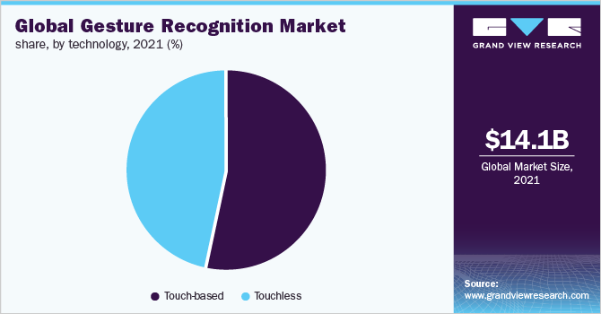

Slide 18
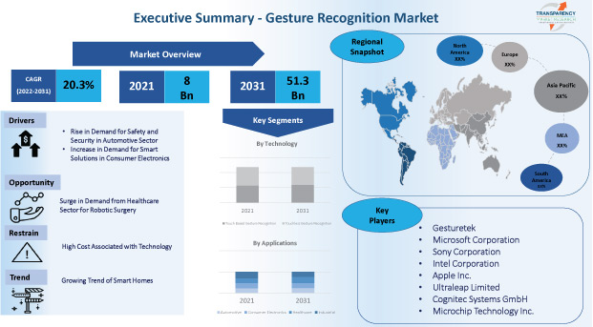

Slide 19
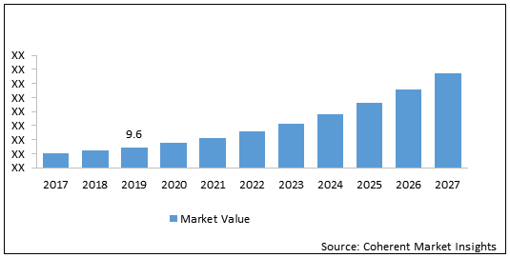
37.6
(expected)
(in billions)

Slide 20
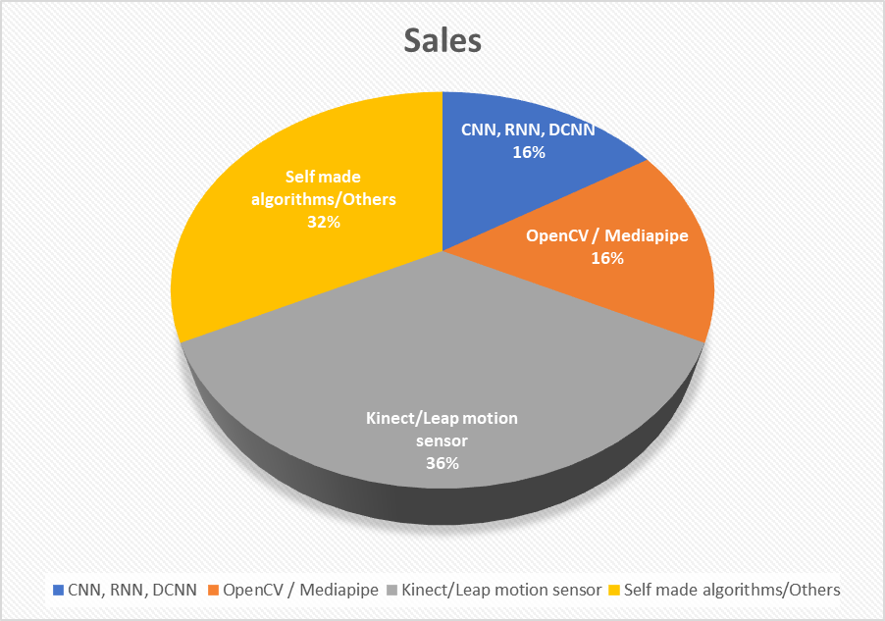
Technology Used In Different Papers -
Total papers - 31
CNN, RNN,DCNN - 5
OpenCV/Mediapipe- 5
Kinect/Leap Motion - 11 ( Kinect => 7 & Leap motion =>4 )
Self Made Algorithms/Others - 10

Slide 21
Deep learning (CNN, RNN, DCNN) and OpenCV/ Mediapipe are the latest technologies in Gesture recognition field.
After 2016, most of the Recognition technology use Deep learning or OPenCV/Mediapipe.
OpenCV/Mediapipe is very easy to use and give good results.
One of the most used technology in gesture recognition is Microsoft Kinect.
It provides its own in build algorithm.

Slide 22
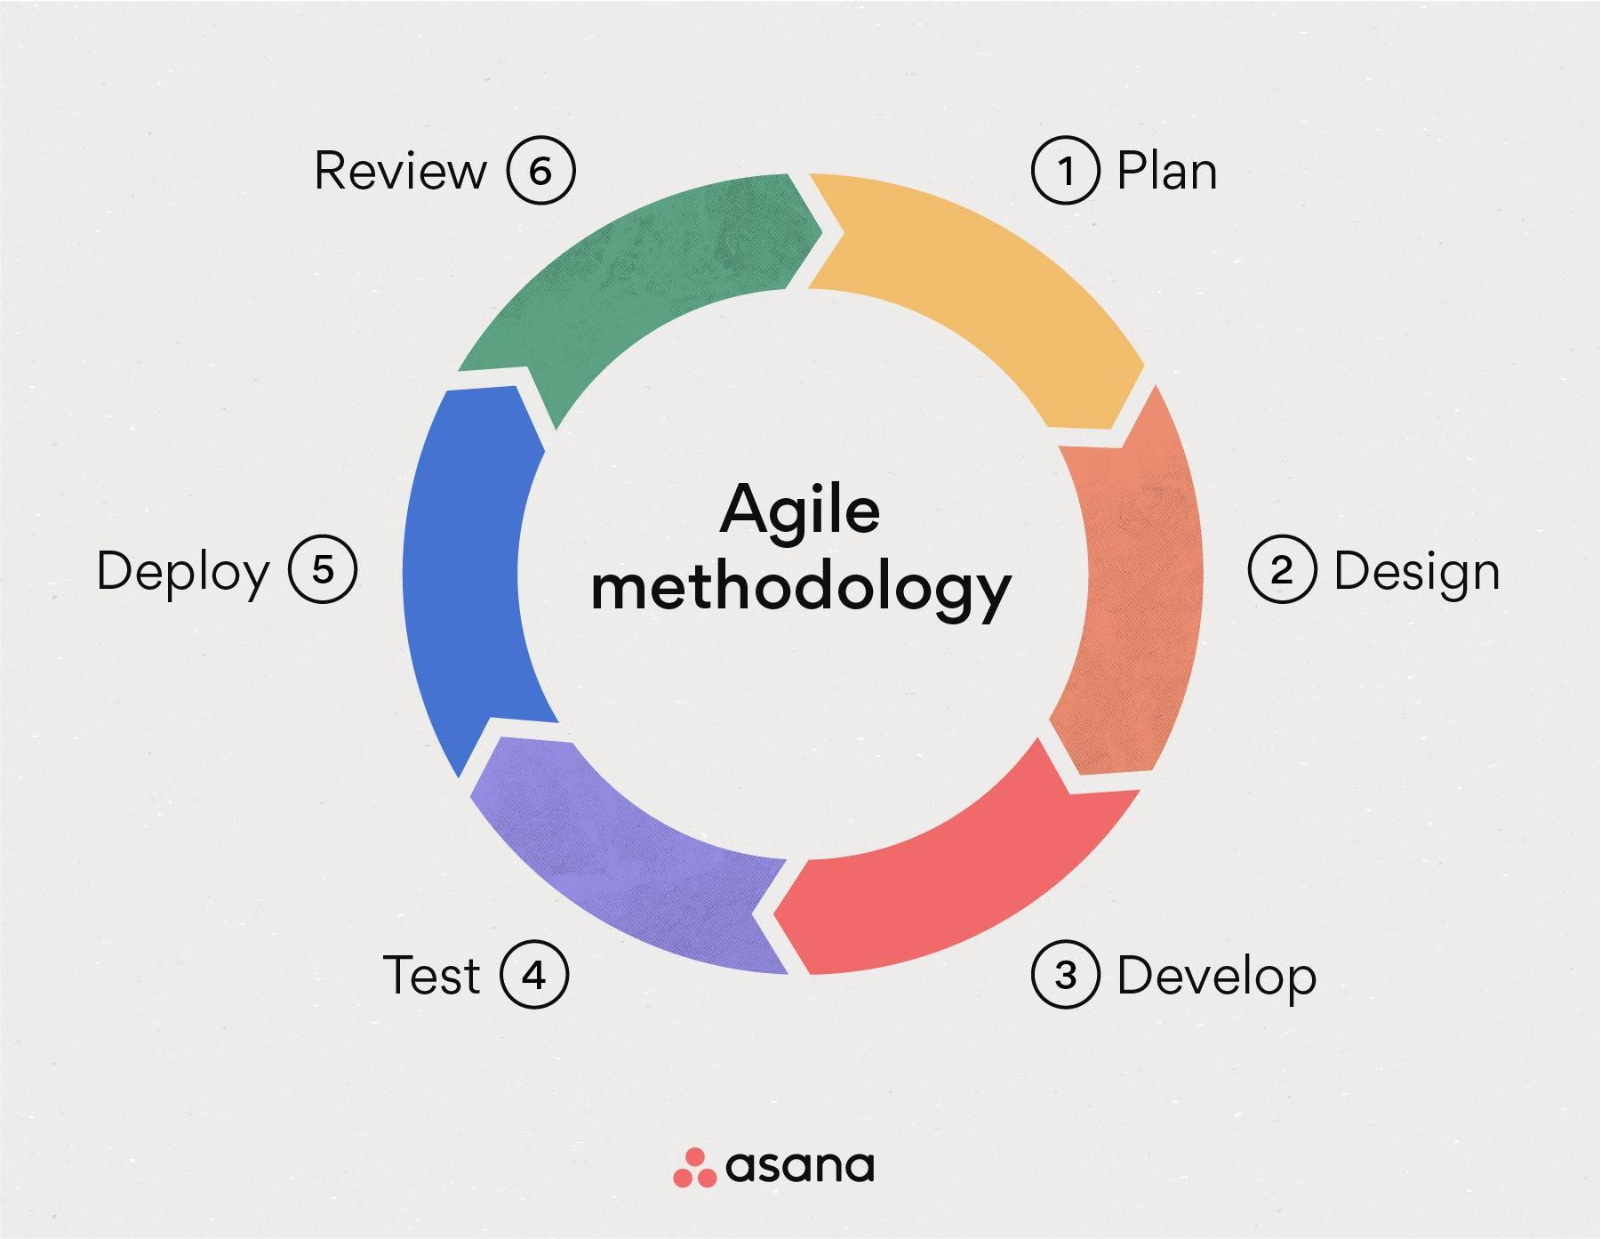
Selection of SDLC Model
We have chose to develop our software through Agile Model
The advantages of the Agile Model are as follows −
In the field of software development, it is the most used approach as it is based on realistic approach.
This model encourage teamwork.
Functions can be added to the software or modifications can be done and they can be demonstrated and tested.
It helps in minimising the use of any extra resources.
If there is changing requirements, it is best suited for that.
Partial working solutions are delivered early.
The models which changes steadily it is best suited for them.
Rules are minimum,and documentation can be done easily.
Enables concurrent development and delivery within an overall planned context.
Less planning is required in this model.
Management in this model is easy
it is flexible to developers

Slide 23
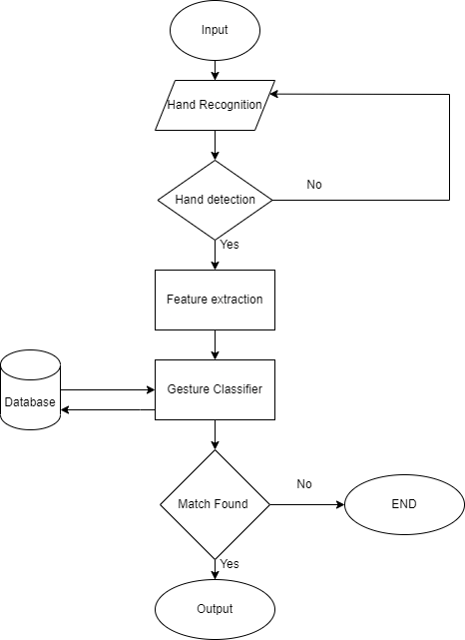
Flowchart of Hand Gesture

Slide 24
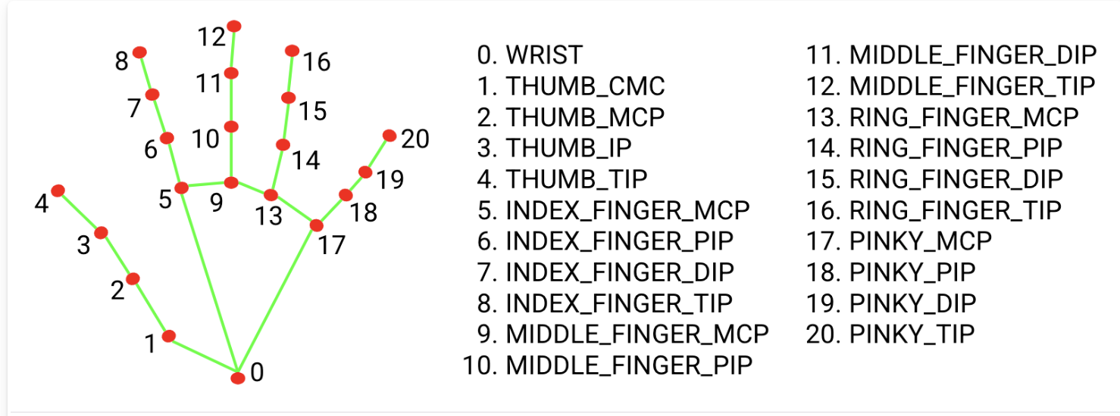
This module deals with the recognition of hand movements in the live image
We have used Mediapipe hands.
Hand recognition model is divided into two parts
Palm detection model
Hand landmark model

Slide 25
Implementation
First step is to initialize the camera and start capturing frames. These frames can then be passed through the Mediapipe hand tracking module, which will identify the hand's keypoints and generate a 3D hand pose estimation.
Using the 3D hand pose estimation, OpenCV can be used to extract features from the hand, such as the position of the fingers and the orientation of the palm.
Then the 3D model was normalized to 2D.
We take wrist point as the origin and we reduce it from other hand point, and then convert them to in range of 0-1. For eg-
wrist point =(600,300) is taken as origin Max value = 250
thumb tip =(350,200)
After normalization => (350-600), (200-300)
=> -250,-100
=> -1,-0.4

Slide 26
Then, these normalized values are used to record different gestures and create dataset, and then a model is trained to identify these gestures.
Once the recognised gesture is made the most in span of 2 sec is considered as the gesture being made by the user, then the related OS function is performed.

Slide 27
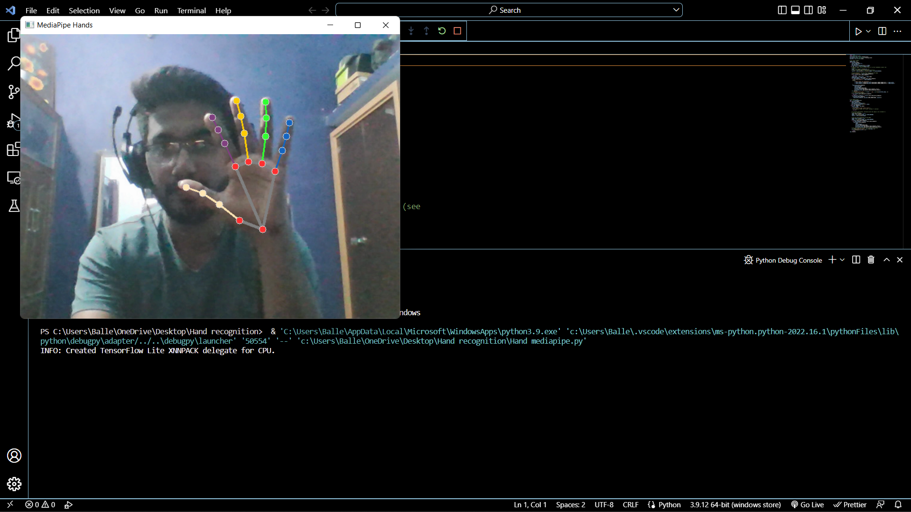
Hand gesture recognition

Slide 28
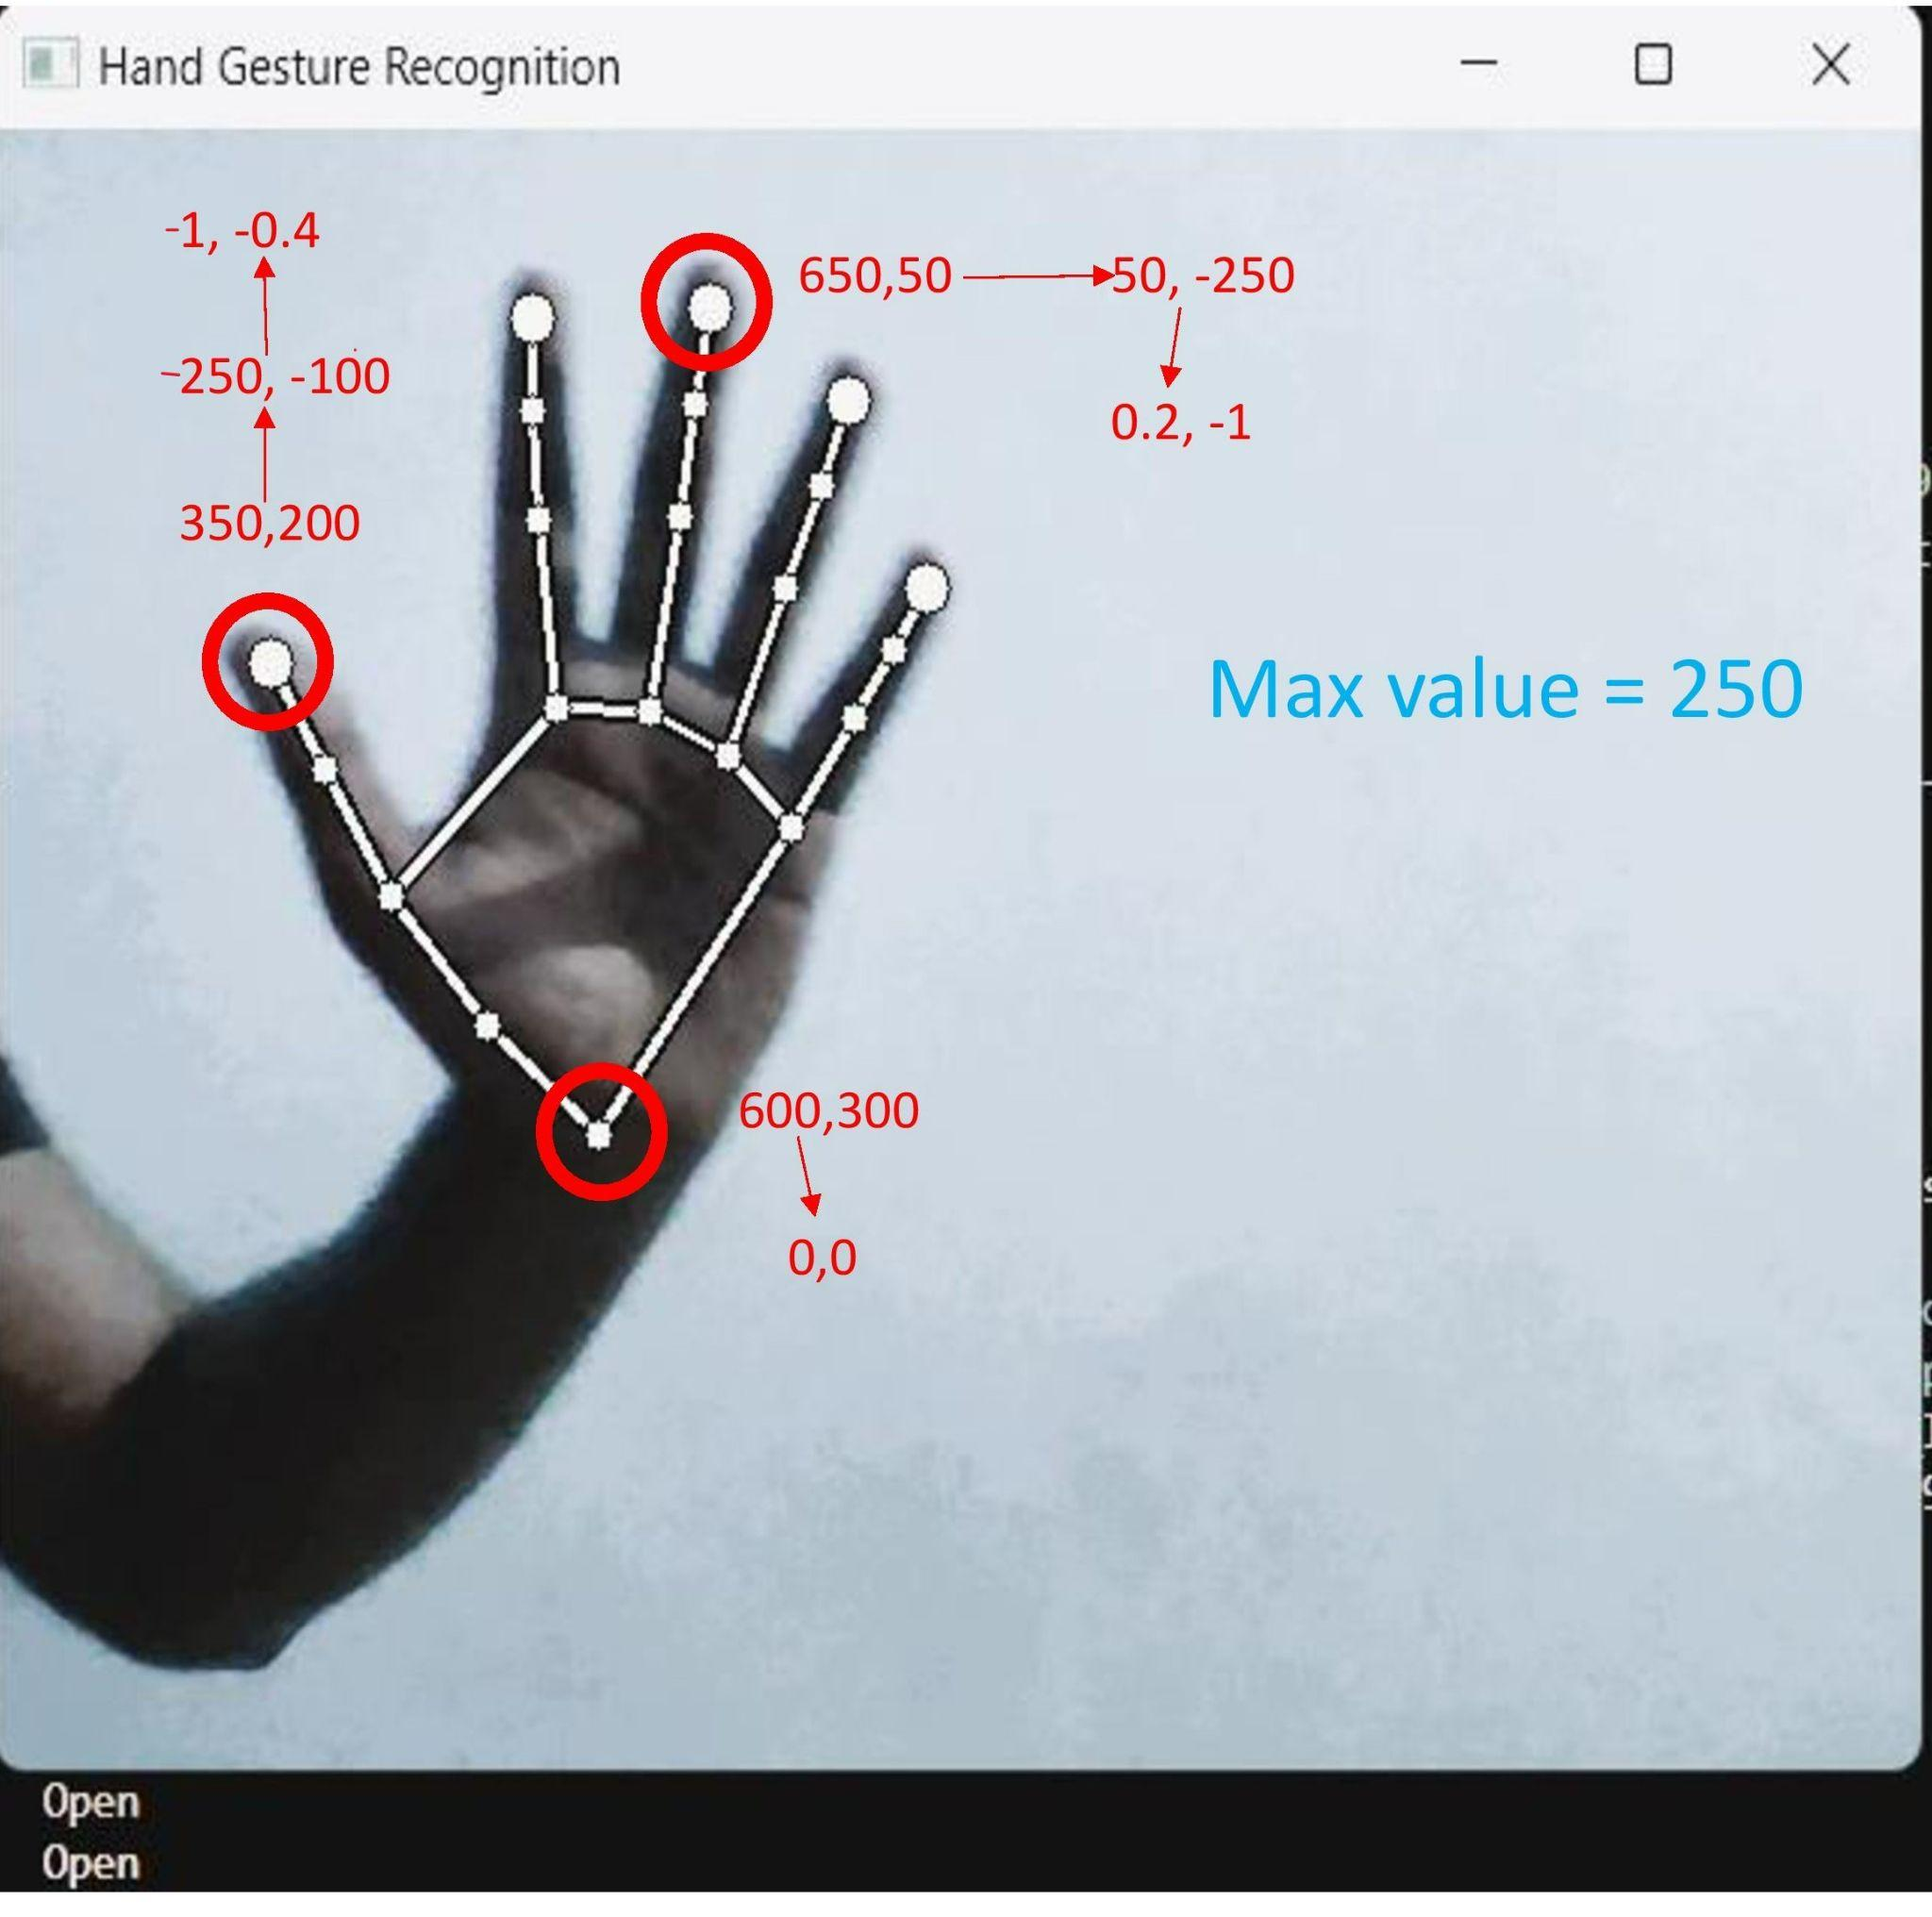

Slide 29
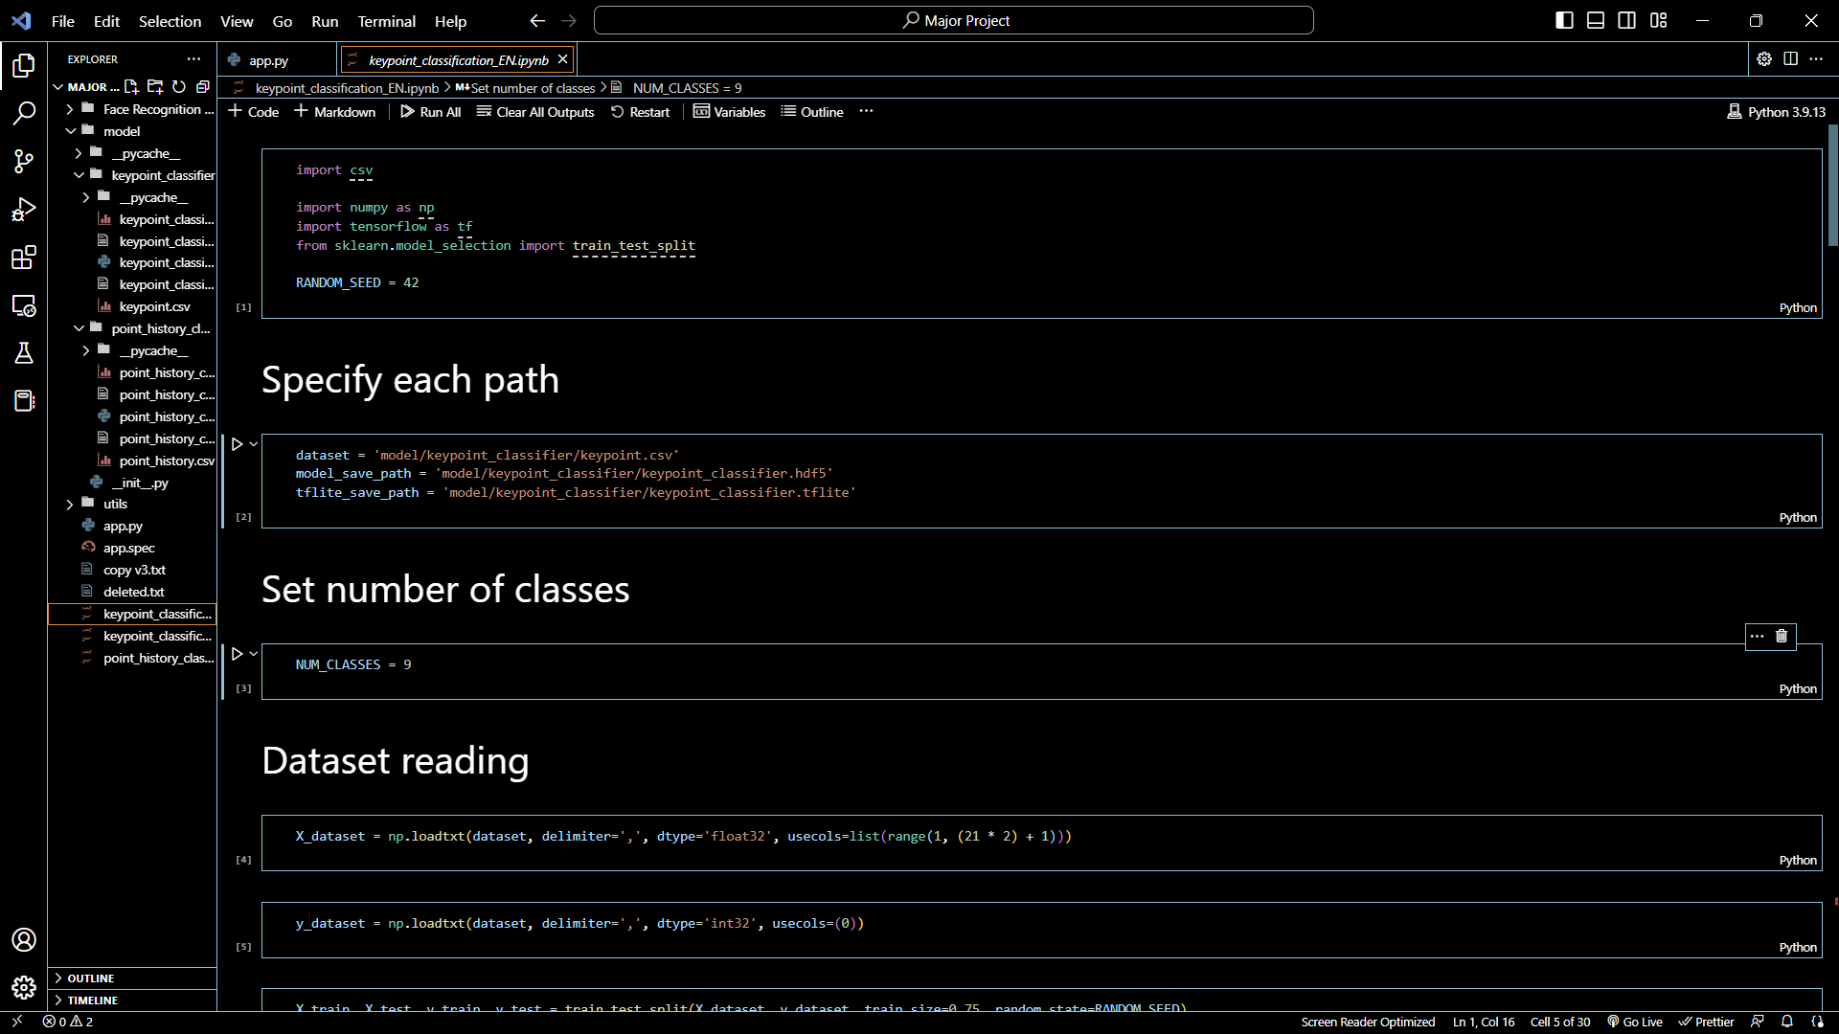
Model Trainer

Slide 30
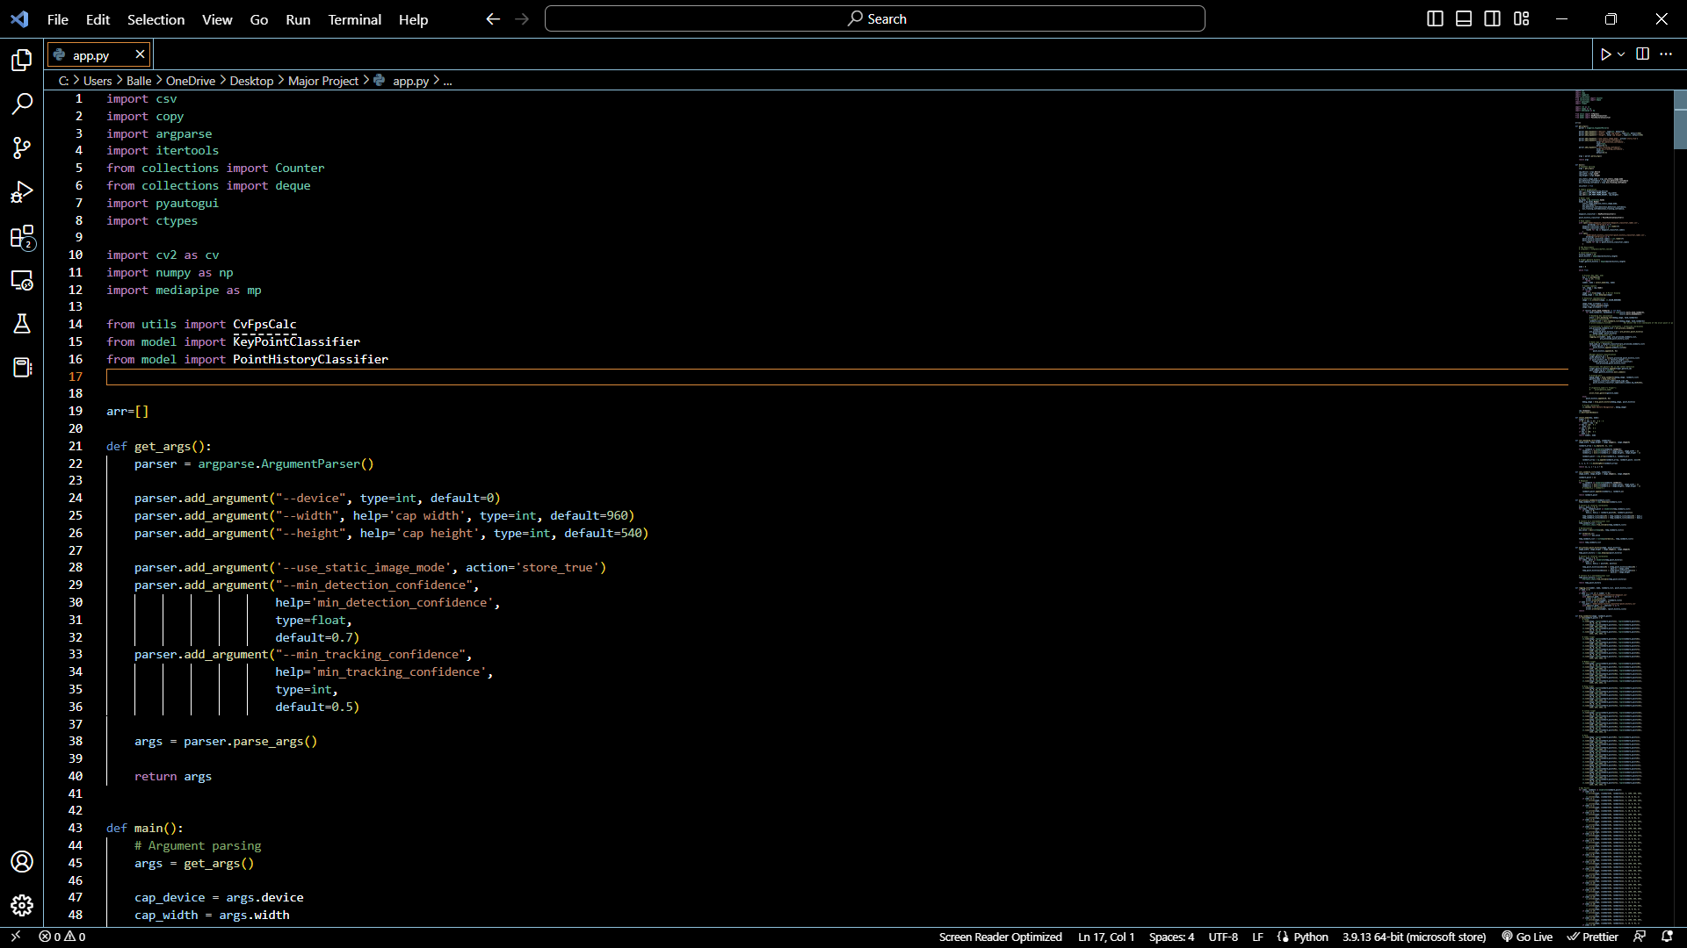
Gesture recognition app:

Slide 31
Gestures Recognised by our Model -
Static Gestures -
Open Hand
Close Hand
OK Sign
Peace Sign or V Sign
Thumbs Up
Thumbs Down
Pinch In
Pinch Out
Dynamic Gestures- (1 Finger (Used for dynamic gesture recognition activation)
Clockwise
Counter Clockwise
Move Left
Move Right
Move Up
Move Down

Slide 32
Gesture and what it does -
Open Hand | Play/Pause
Close Hand | Close the current window
OK Sign | Save
Peace Sign or V Sign | Mute / Unmute
Thumbs Up | Top of page
Thumbs Down | Bottom of page
Pinch In | Zoom Out
Pinch Out | Zoom In
Clockwise | Go to main screen || Minimize all windows/maximize all windows
Counter Clockwise | Lock Windows
Move Left | Previous Slide / Seek video backward
Move Right | Next slide / Seek video forward
Move Up | Volume Up
Move Down | Volume Down

Slide 33
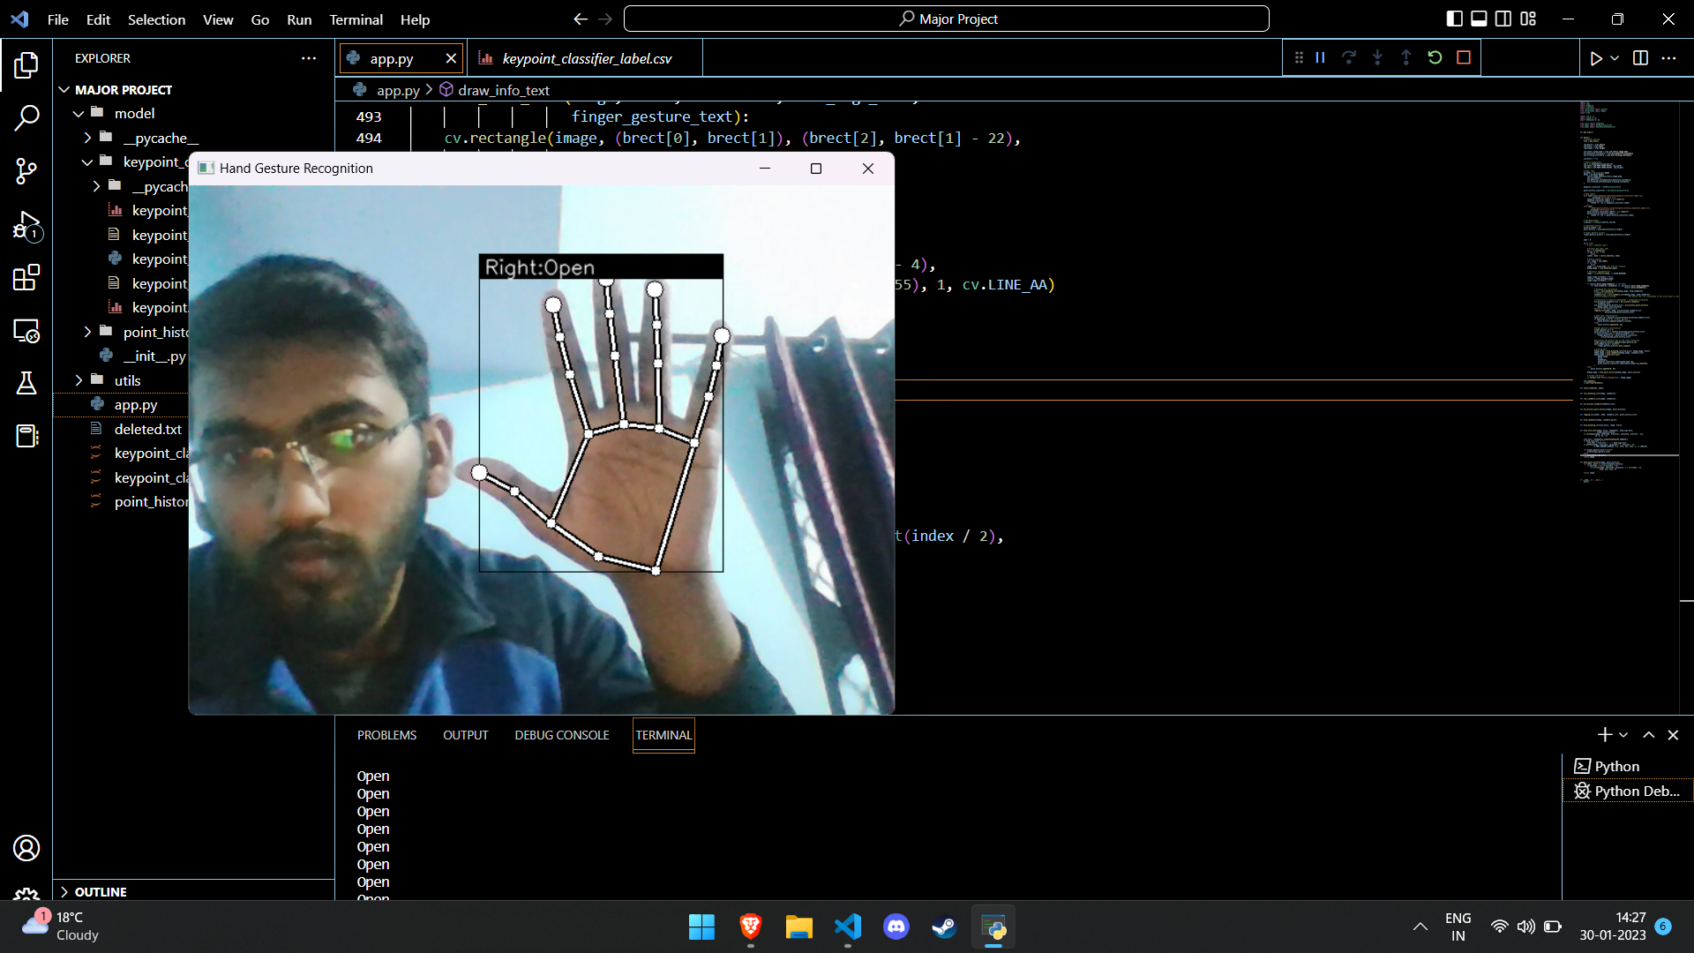
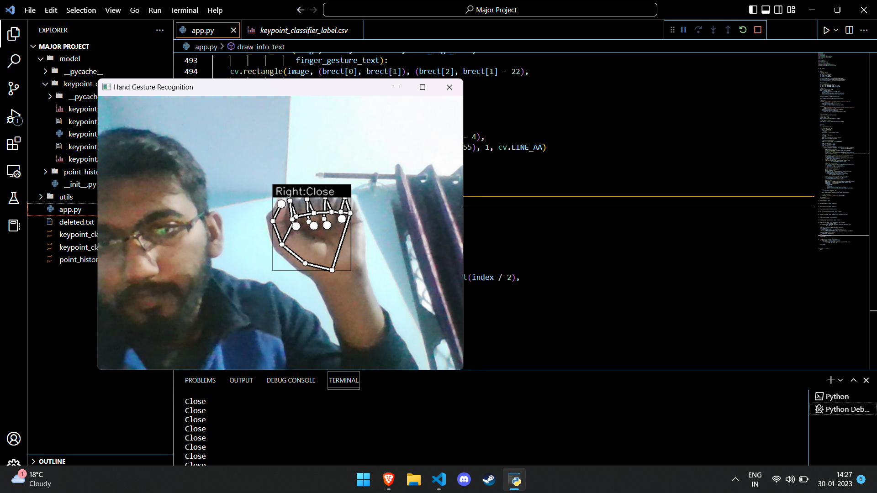
Open & Close Hand Gesture - Recognition Working Sample

Slide 34
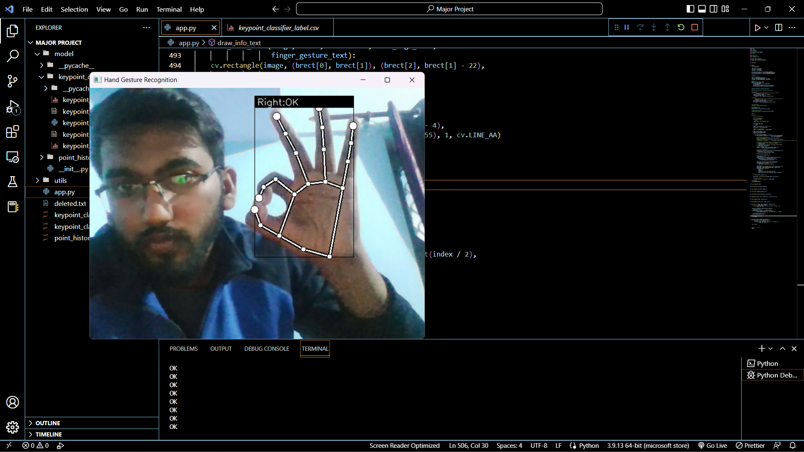
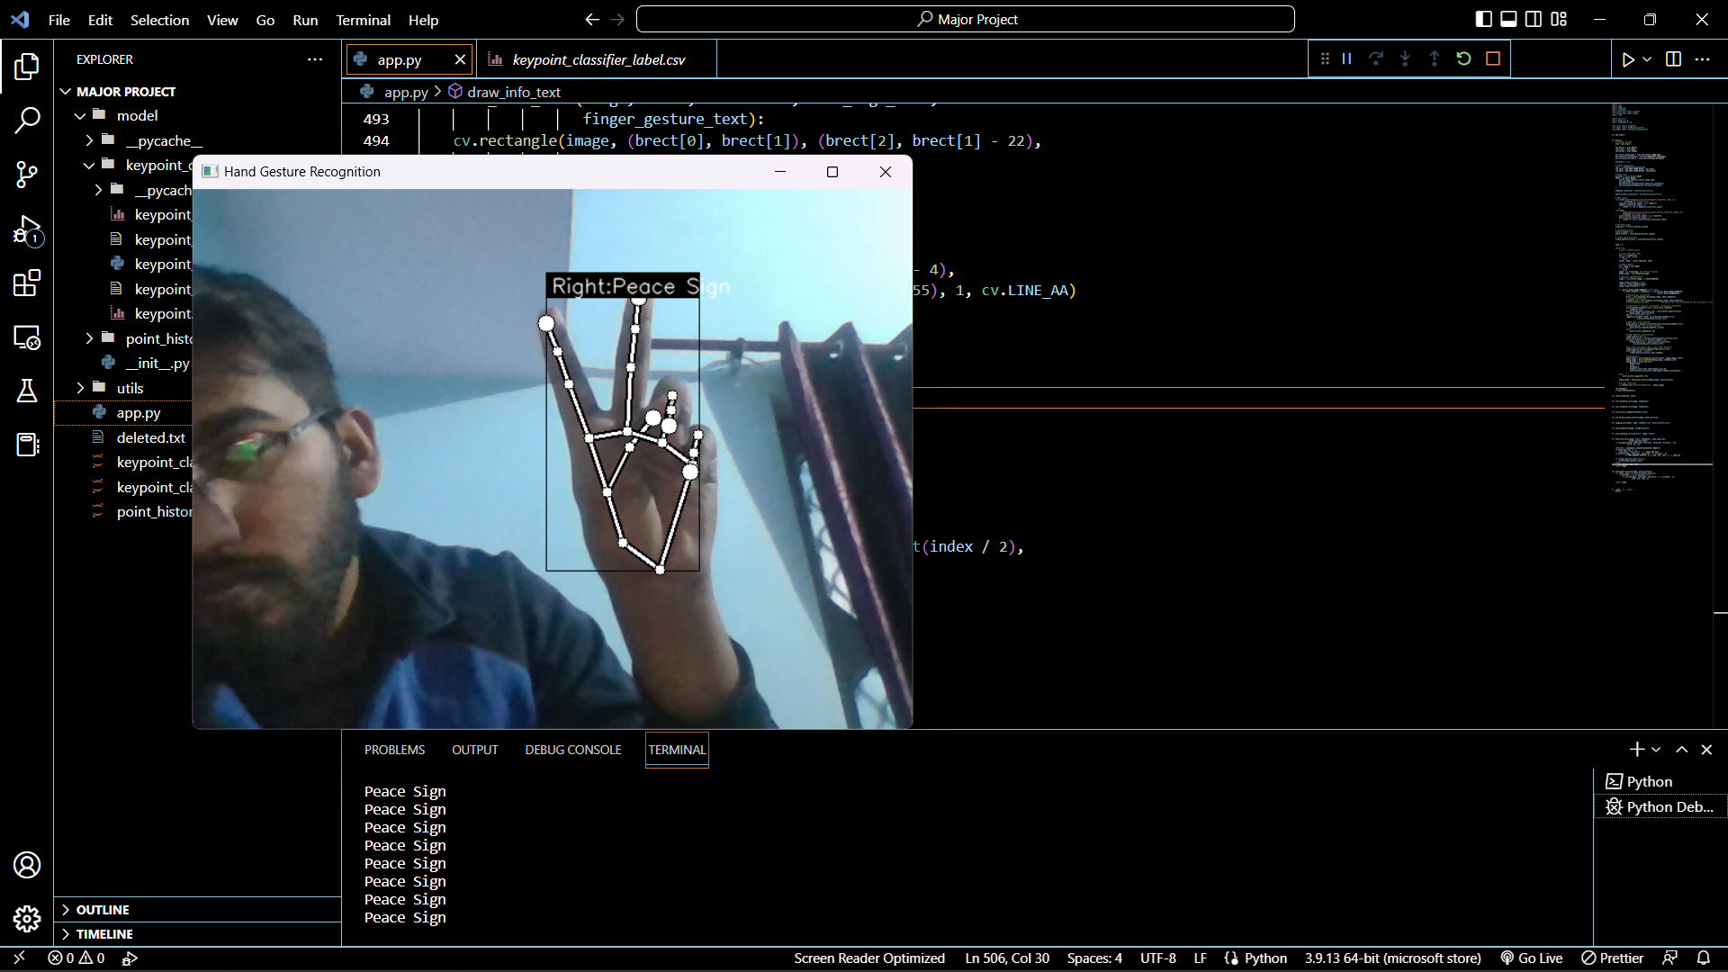
OK and Peace Sign Hand Gesture - Recognition Working Sample

Slide 35
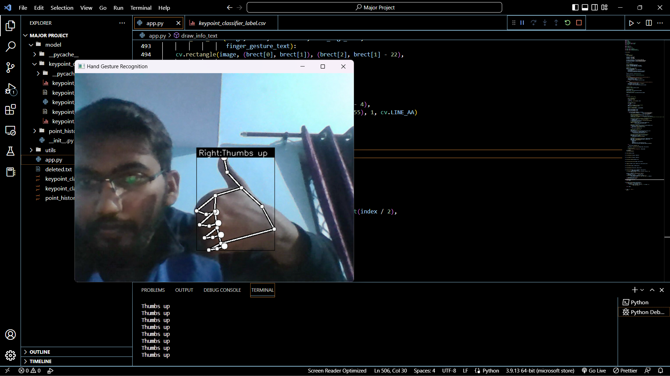
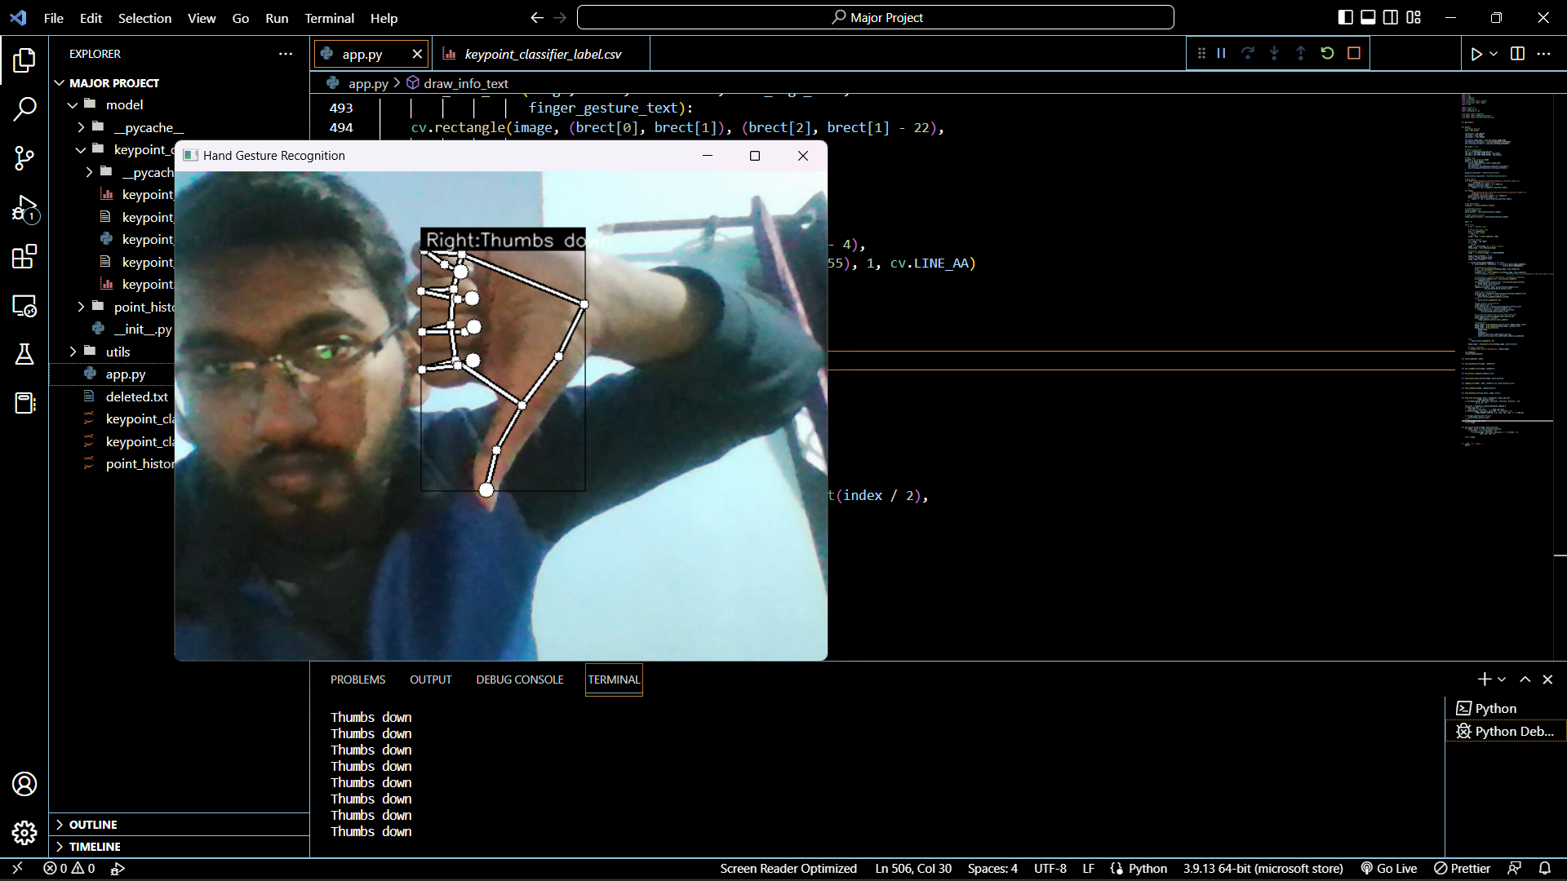
Thumbs Up and Down Hand Gesture - Recognition Working Sample

Slide 36

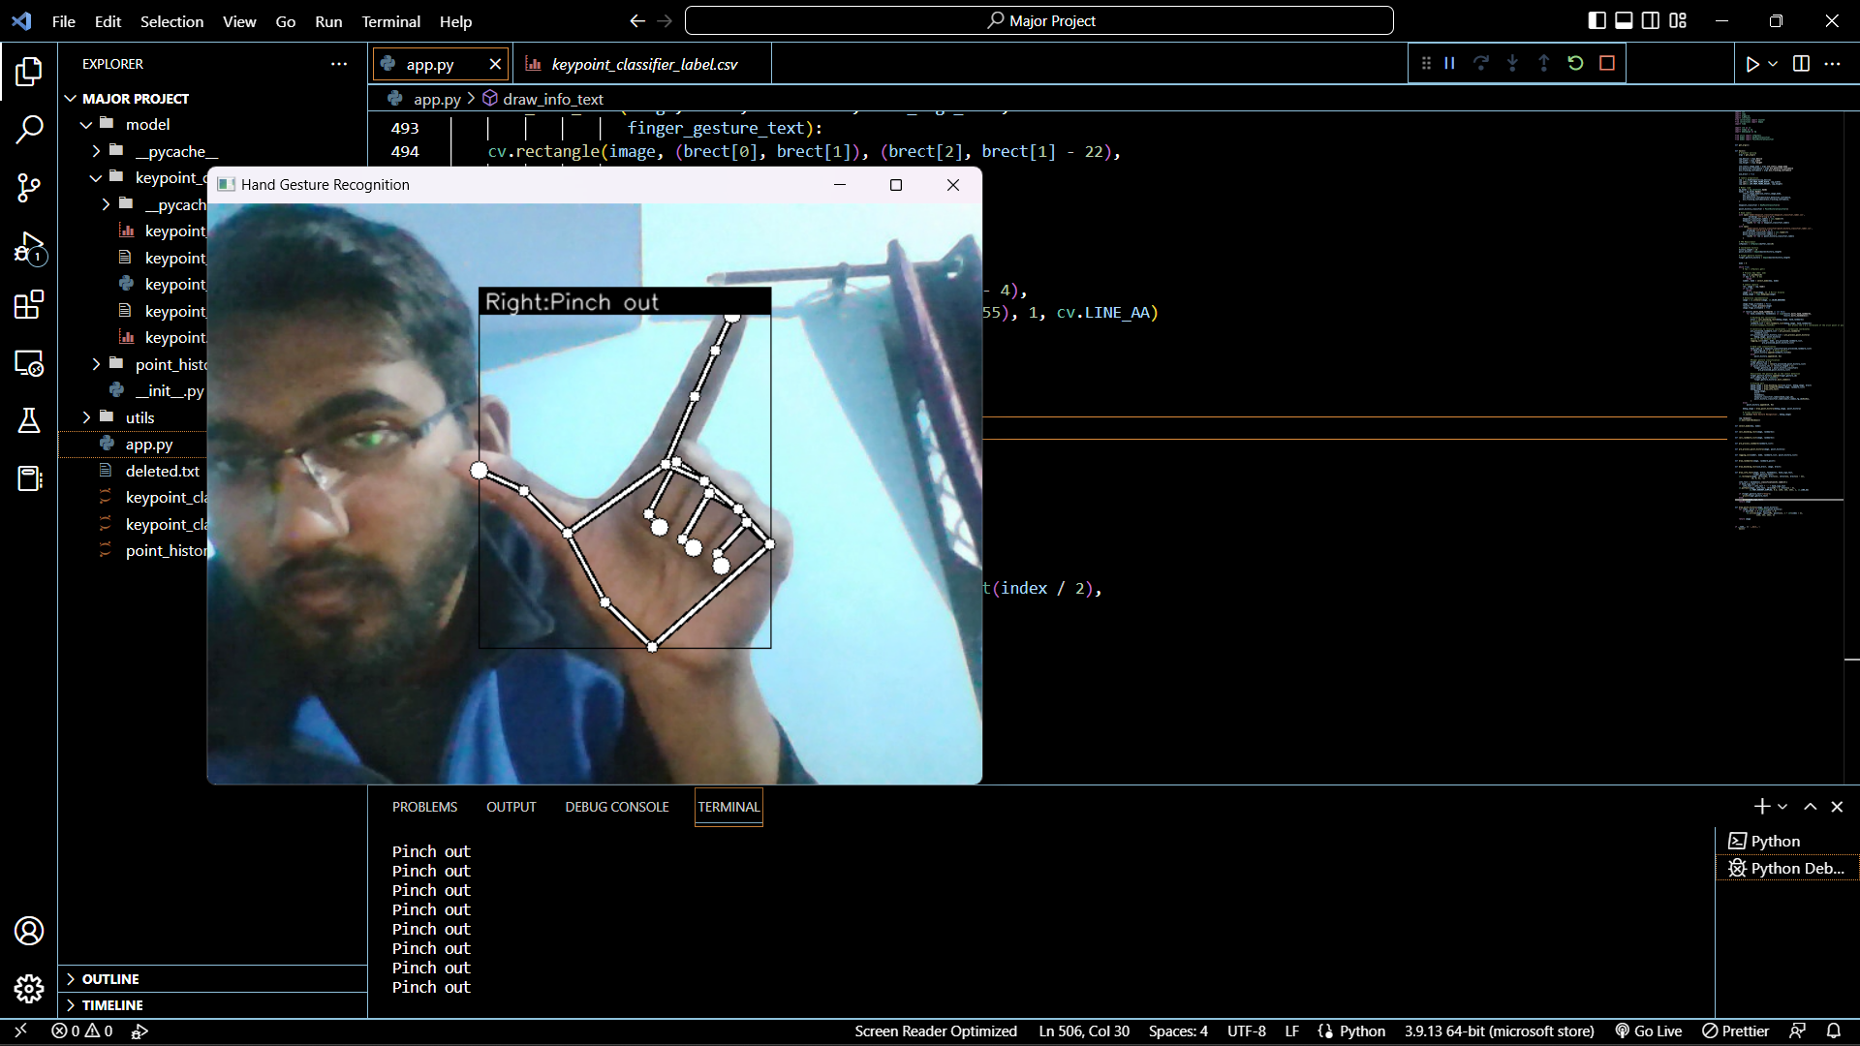
Pinch In and Out Hand Gesture - Recognition Working Sample

Slide 37
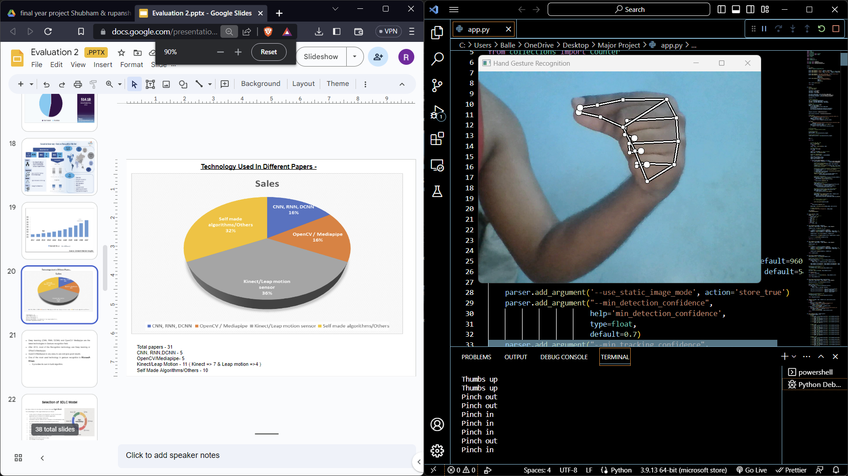
Gesture working outputs - Pinch in (zoom out)

Slide 38
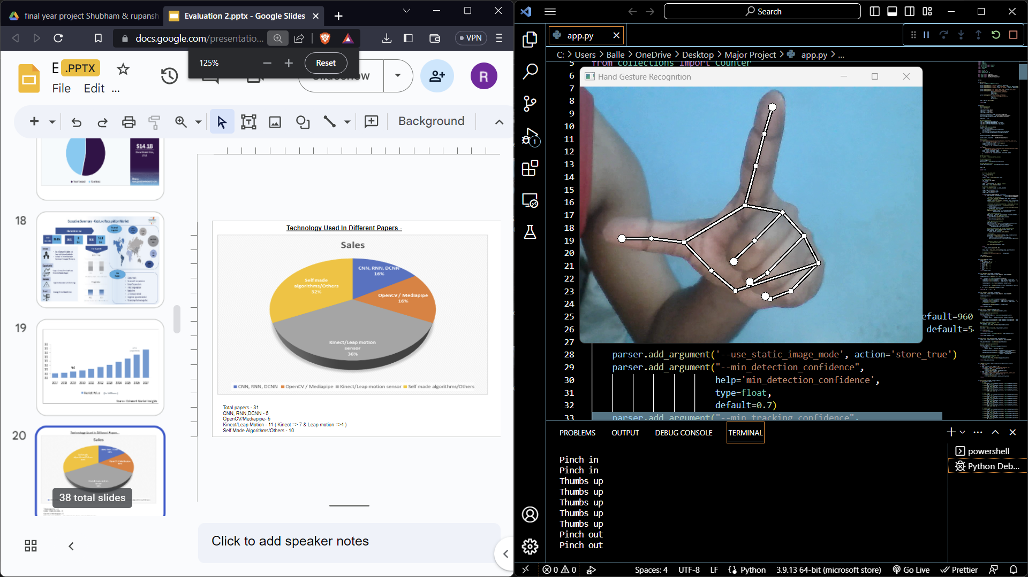
Gesture working outputs - Pinch out (zoom in)

Slide 39
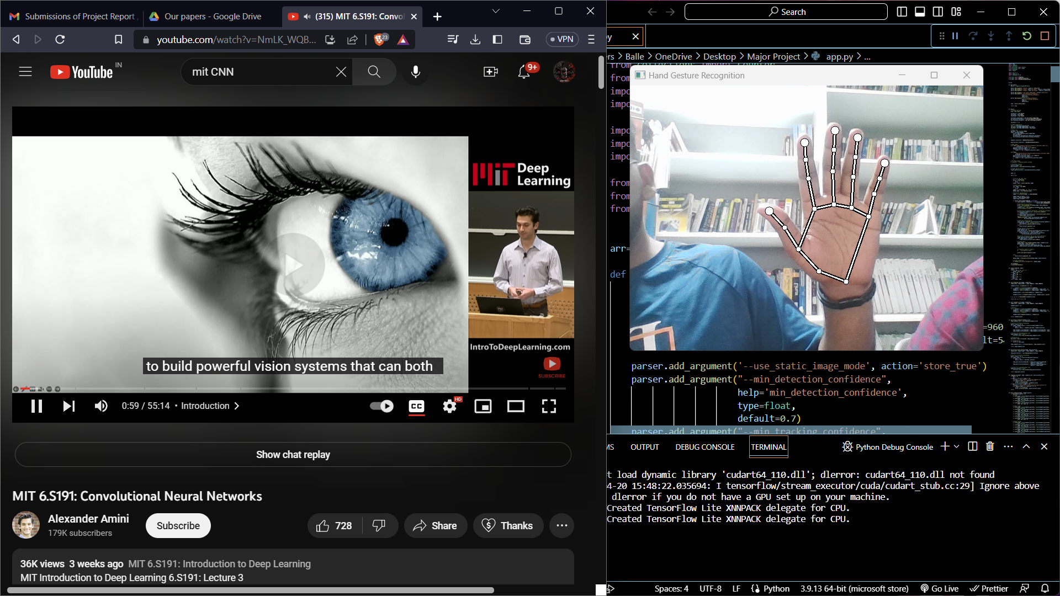
Gesture working outputs - Open hand (play/pause)

Slide 40
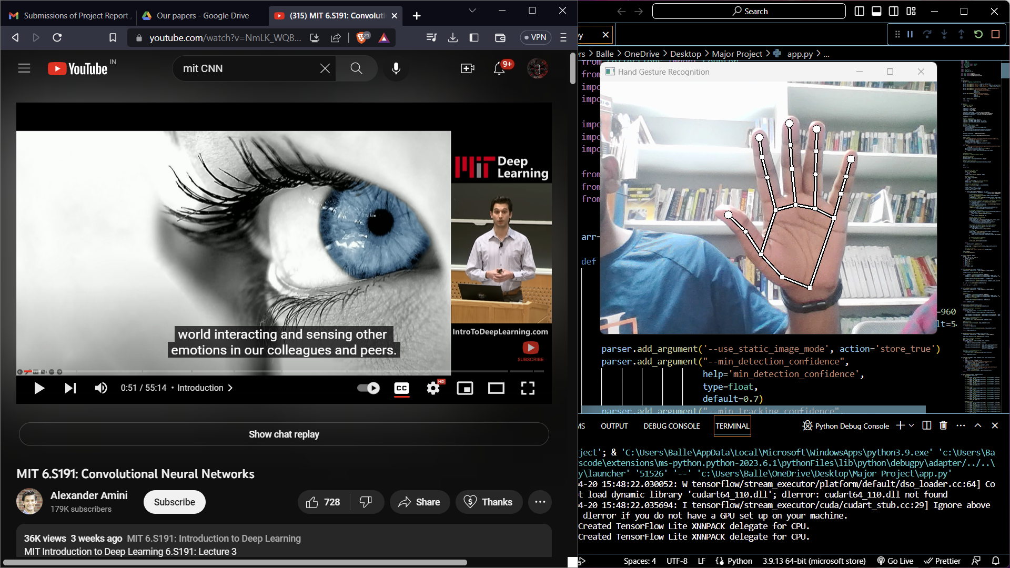

Slide 41
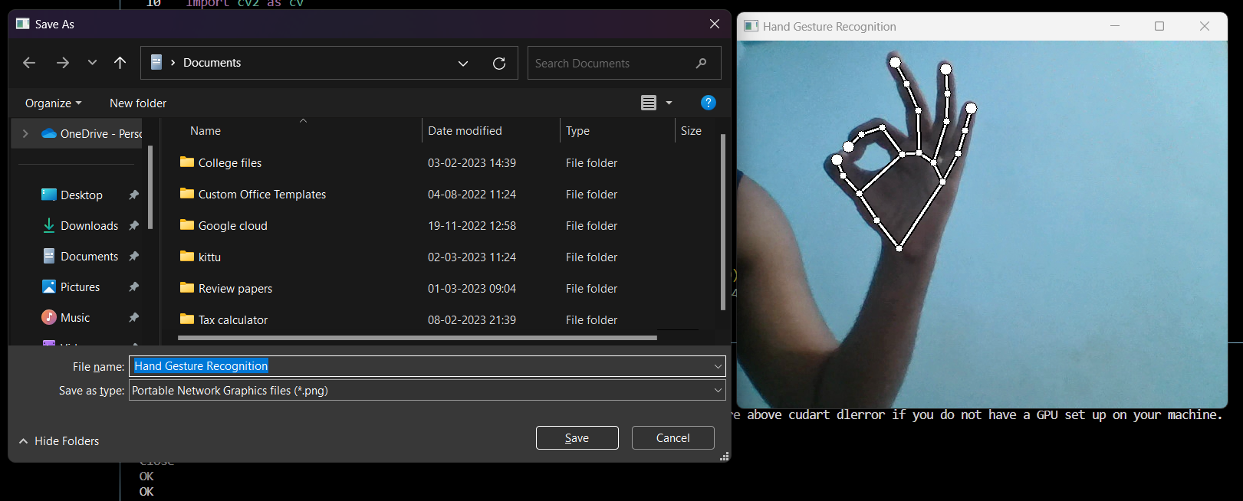
Gesture working outputs - Ok sign(Save )

Slide 42
Future work/ scope -
Facial recognition can be added with gesture recognition, so only the recognized user's hand gesture is captured.
Different security techniques can be included to make it more secure.
More dynamic and static gestures can be added.
Size of training dataset can be increased to increase the accuracy of the model.

Slide 43
Thank You

